Slide 1
CSE 460: VLSI Design
Lecture 10: Finite State Machines (part 3)

Slide 2
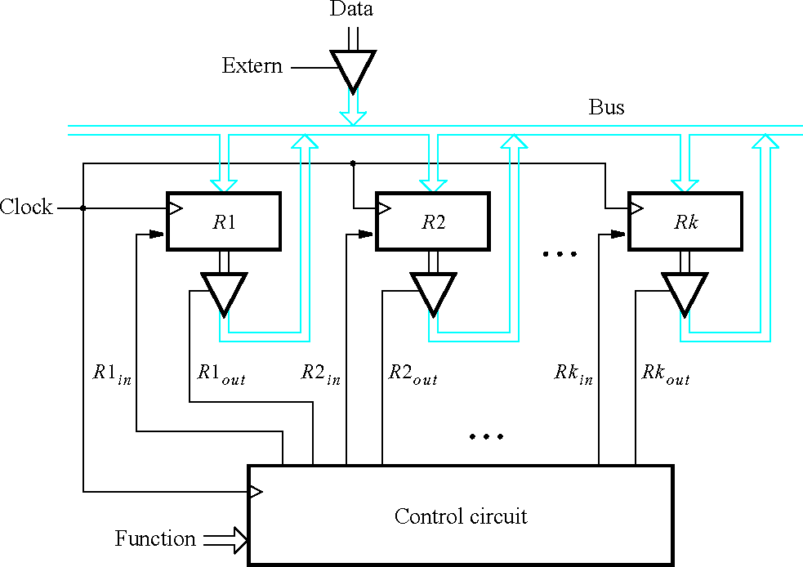
Example-3: Swapping Contents of two registers
Figure 7.55.
A digital system with k registers.

Slide 3
Example-3: Swapping Contents of two registers
Sometimes it is necessary to swap the contents of two registers. Typically, this is done by using a temporary location, which is usually a third register.
For example, suppose that we want to swap the contents of registers R1 and R2. We can achieve this by first transferring the contents of R2 into the third register, say R3. Next, we transfer the contents of R1 into R2. Finally, we transfer the contents of R3 into R1.

Slide 4
Example-3: Swapping Contents of two registers
^{R1}out R1_{in}
^{R2}out R2
Task:
R2 -> R3
R1 -> R2
R3 -> R1
w
Control
circuit
Clock
in
^{R3}out R3_{in}
Done
Figure 8.10.
Signals needed in this example.

Slide 5
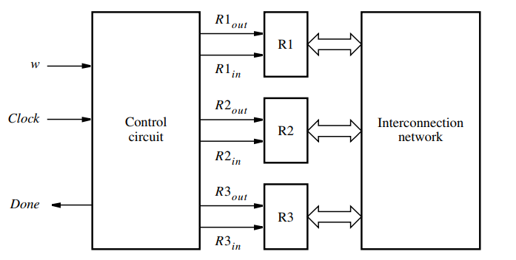
Example-3: Swapping Contents of two registers
/
Data Bus
Figure 6.10 The whole system for this example

Slide 6
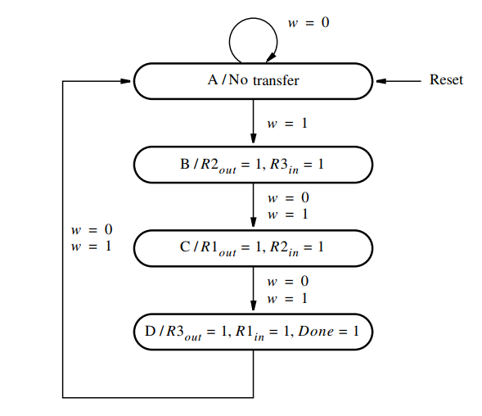
Example-3: Swapping Contents of two registers (Moore Type)
Once the swapping request arrives (w=1), w is neglected until the process ends (done=1)
Steps->
State diagram
State table
State assigned table
K-map
Circuit
Figure 8.11.
State diagram for this example.

Slide 7















Example-3: Swapping Contents of two registers
Present state | Next |  |  | state |  | Outputs
 | w | = | 0 | w | = 1
A | A |  | B |  |  | 0 | 0 | 0 | 0 | 0 | 0 | 0
B | C |  | C |  |  | 0 | 0 | 1 | 0 | 0 | 1 | 0
C | D |  | D |  |  | 1 | 0 | 0 | 1 | 0 | 0 | 0
D | A |  | A |  |  | 0 | 1 | 0 | 0 | 1 | 0 | 1
Figure 8.12.
State table for Example 8.1.
Steps->
State diagram
State table
State assigned table
K-map
Circuit

Slide 8























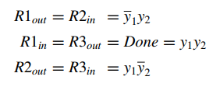
Example-3: Swapping Contents of two registers
Present state | Next | state | Outputs
00 | 00 | 0 1 | 0 | 0 | 0 | 0 | 0 | 0 | 0
01 | 10 | 1 0 | 0 | 0 | 1 | 0 | 0 | 1 | 0
10 | 11 | 1 1 | 1 | 0 | 0 | 1 | 0 | 0 | 0
11 | 00 | 0 0 | 0 | 1 | 0 | 0 | 1 | 0 | 1
A B C D
Figure 8.13.
State-assigned table for the sequential circuit in Figure 8.12.
Steps->
State diagram
State table
State assigned table
K-map
Circuit
outputs = f(y₁,y₂)

Slide 9
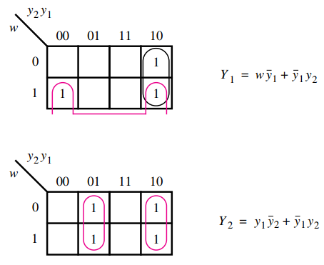
Example-3: Swapping Contents of two registers
Steps->
State diagram
State table
State assigned table
K-map
Circuit
Note that, (Moore type)
Y = f(w,y₁,y₂)
outputs = f(y₁,y₂)
How many flipflops are required?
Ans: 2

Slide 10
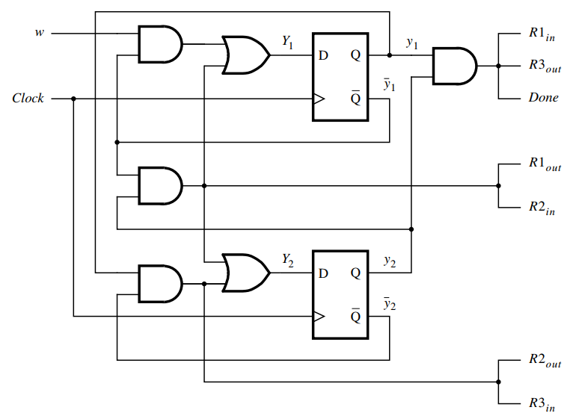
Example-3: Swapping Contents of two registers
Steps->
State diagram
State table
State assigned table
K-map
Circuit
Figure 8.15.
Final implementation of sequential circuit in Figure 8.13.

Slide 11
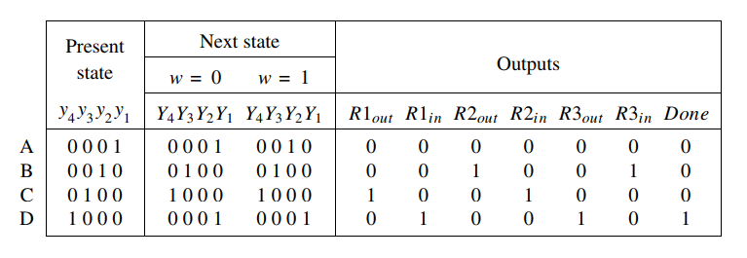
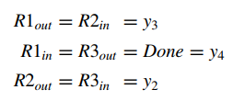
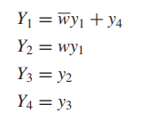
Example-3: Swapping Contents of two registers
Steps->
State diagram
State table
State assigned table
(One-hot encoding)
K-map
Circuit
How many flipflops are required?
Ans: 4

Slide 12
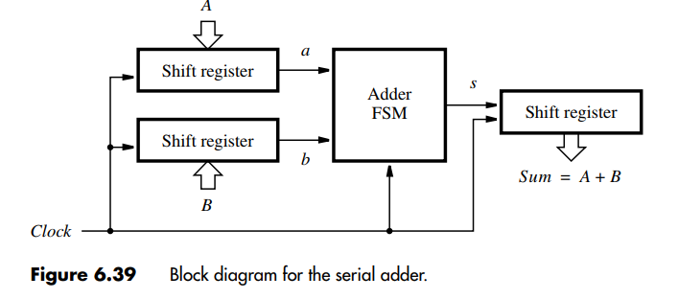
Example-4: Serial Adder

Slide 13
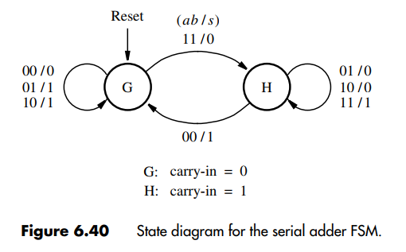
Example-4: Serial Adder (Mealy Type)

Slide 14
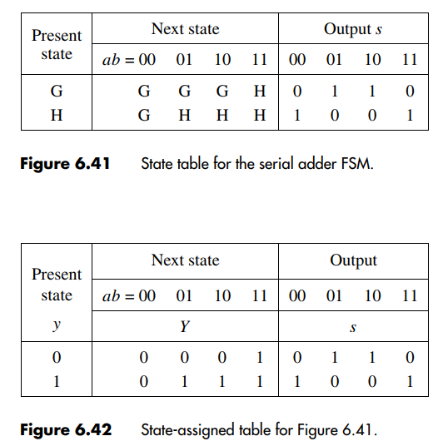

Example-4: Serial Adder (Mealy Type)

Slide 15
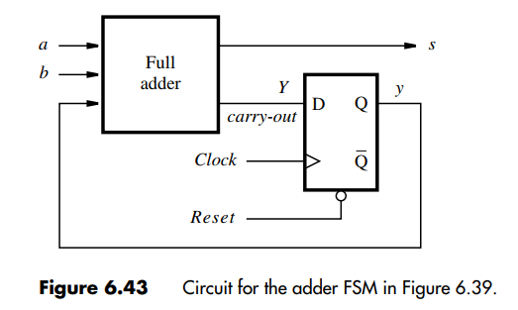
Example-4: Serial Adder (Mealy Type)

